Slide 1
Machine Learning Internship at IIT ISM (DHANBAD) Task-1(Exploratory Data Analysis)

Slide 2
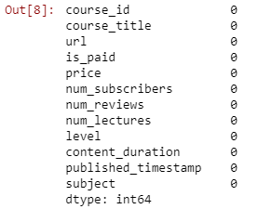
Pre-Processing
Here, We are checking Null-values exist or not in the given dataset.
As we have seen that the given dataset consist of no null values.
Hence, There will not be any default value in the dataset.

Slide 3
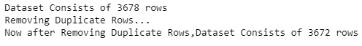
Checking Duplicate Values
Firstly, We have checked the original dataset count which consist of 3678 rows as its showing in the output.
After that removed duplicated rows.
Now, after removing the duplicate rows the dataset consists of 3672 rows.
Which conclude that there was 6 duplicate rows and we have removed them.

Slide 4
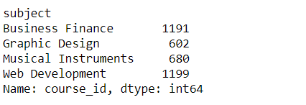
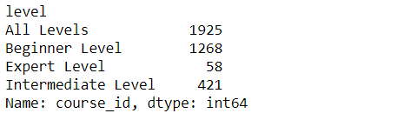
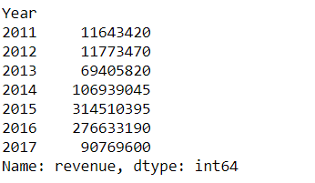
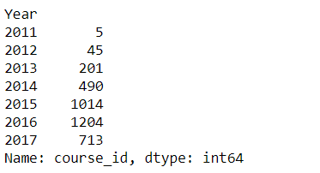
General Analysis
Level By Level Subscribers
Revenue Generated Over the Years
Distribution of Courses over Subjects
No of Courses Distributed Over the years
Revenue Generated Over the Years

Slide 5
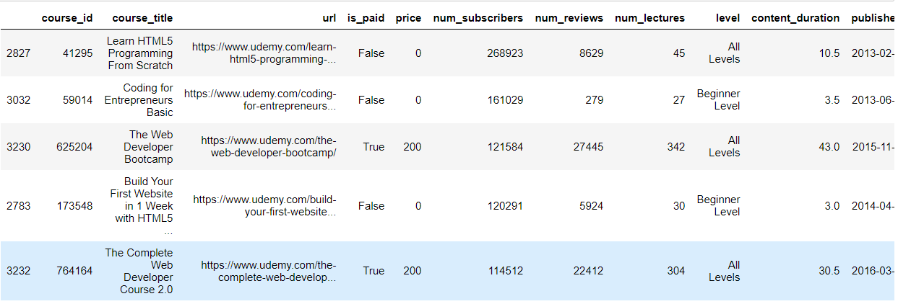

Top 5 Courses with Maximum Number of Subscribers
Courses with Zero Subscribers

Slide 6
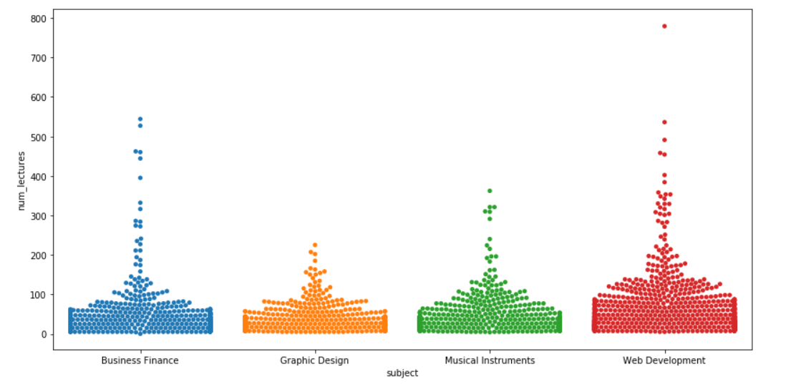
Visualization
In the given plot , the conclusion is that the Web Development has more number of lectures as compared to the given courses and how subscribers are varied over subjects

Slide 7
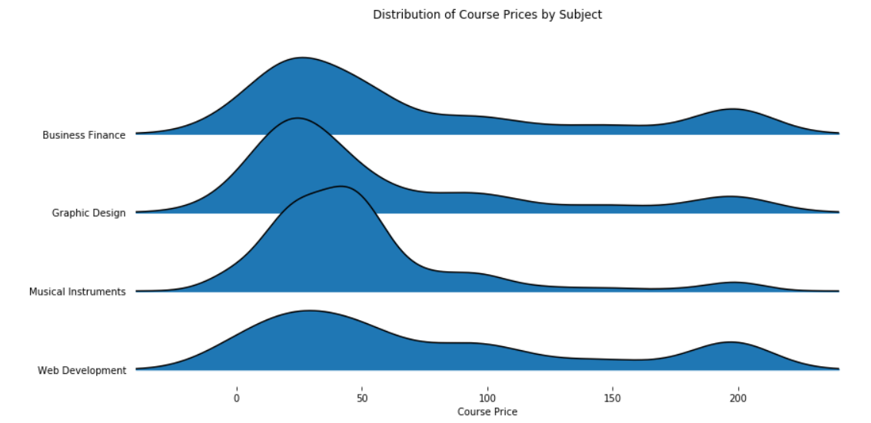
The Visual tells you that how course price have distributed over various subjects

Slide 8
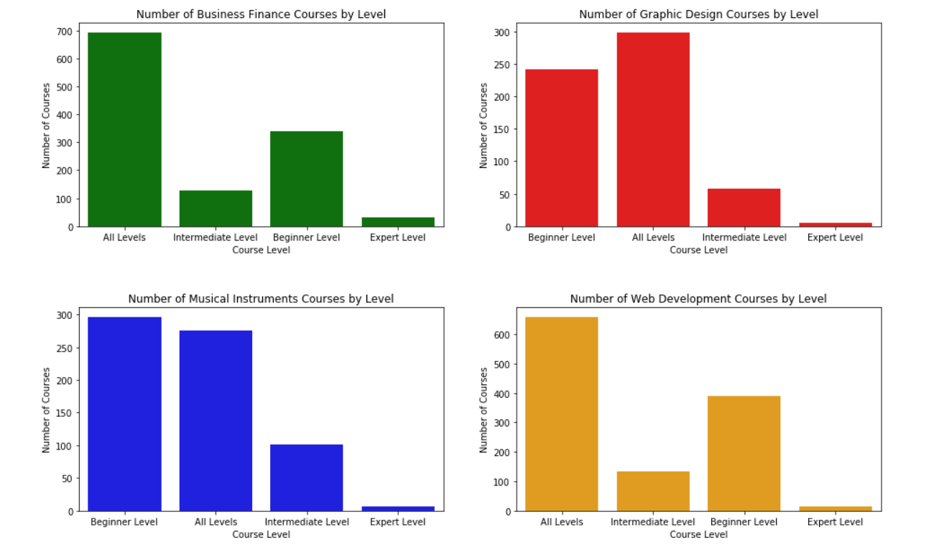
The visual will give you a complete overview of how courses are distributed over levels and subjects. The number of beginners in Web Development is more than any other courses.

Slide 9
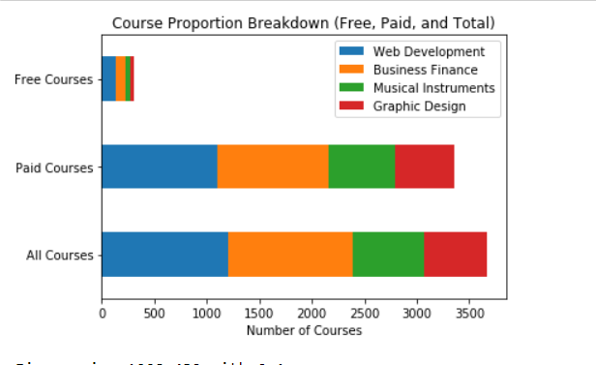
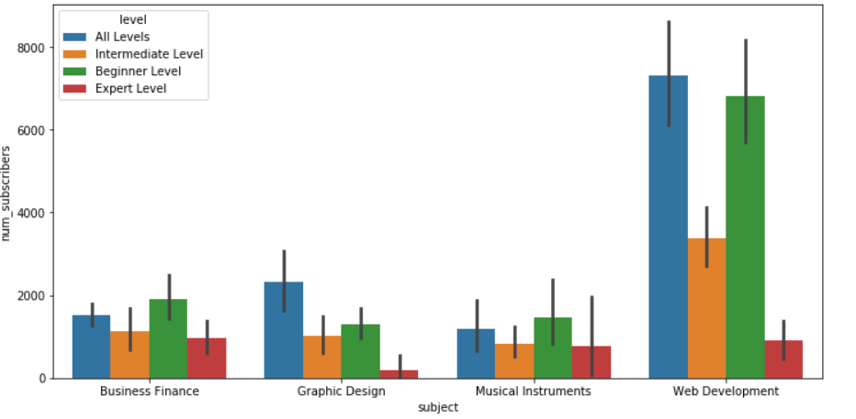
Course Breakdown Proportion (Free,Paid and Total)
Subscribers Distribution over levels and subjects

Slide 10
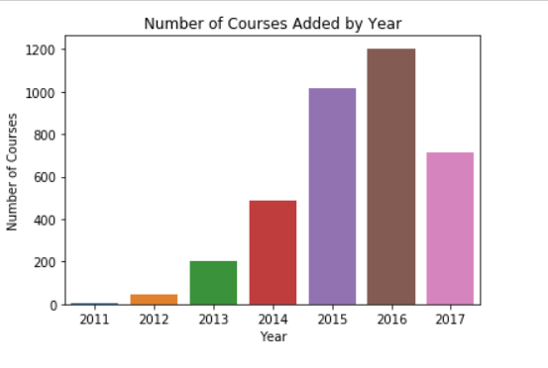
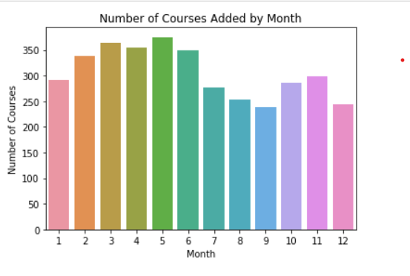
Number of Courses added over Years
Number of Courses added Over Months

Slide 11
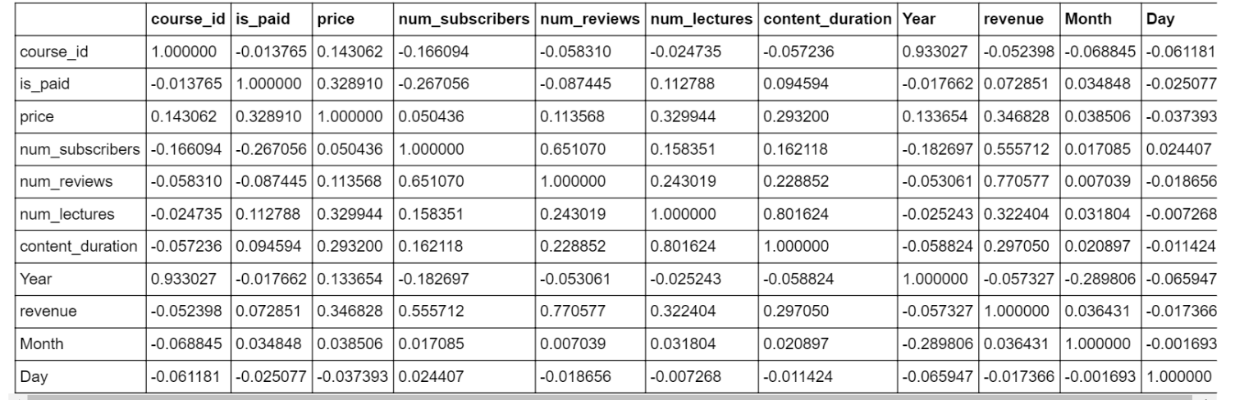
Correlation within the Dataset
Correlating different columns in our data

Slide 12
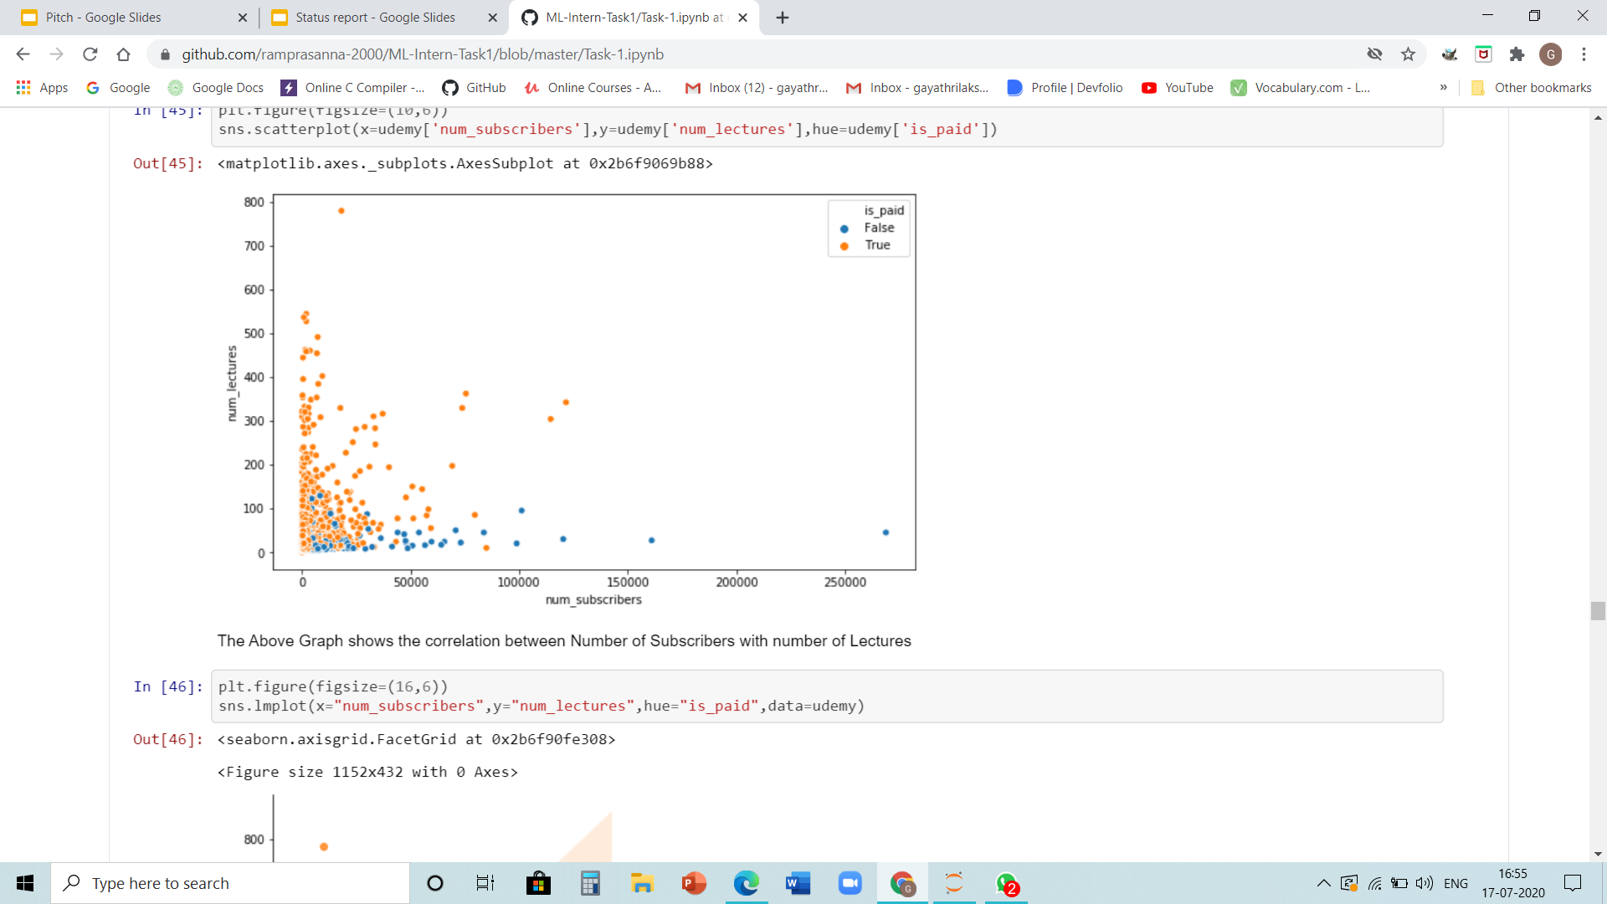
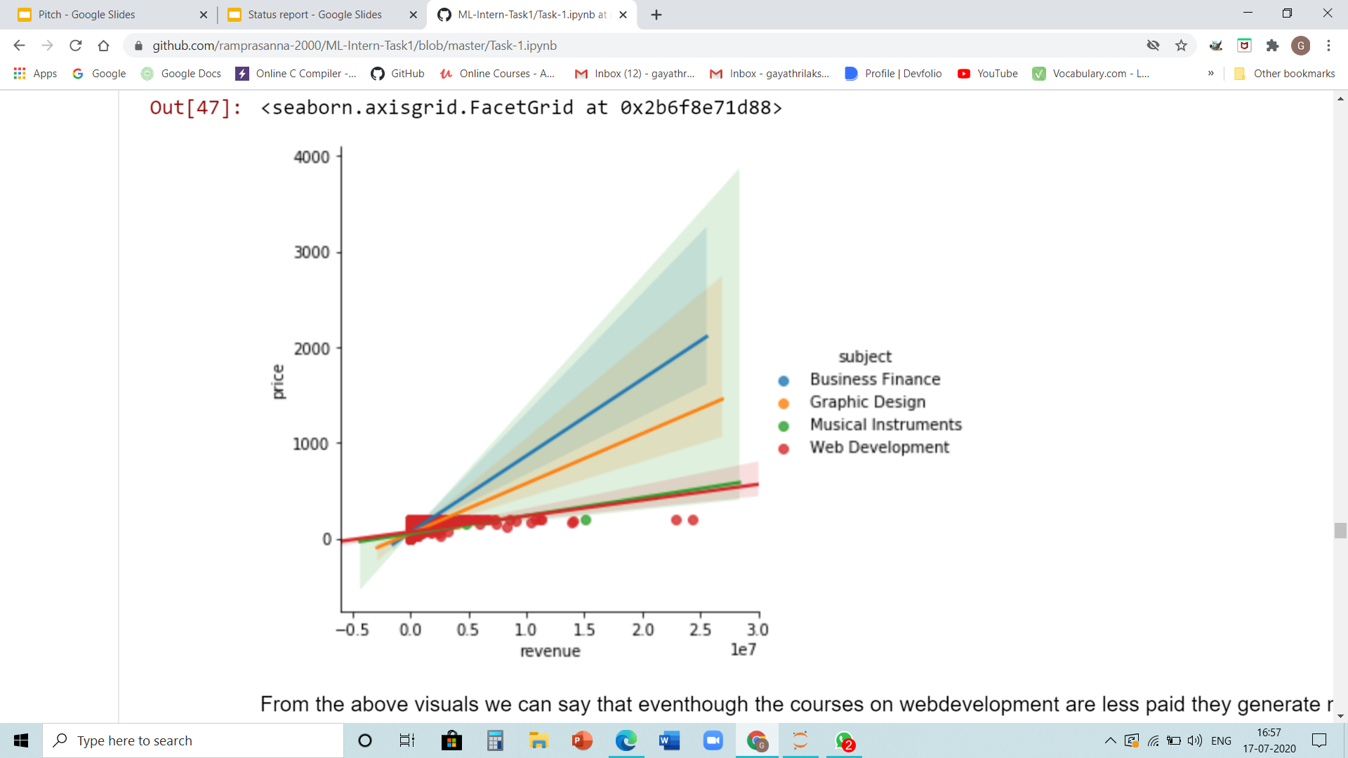
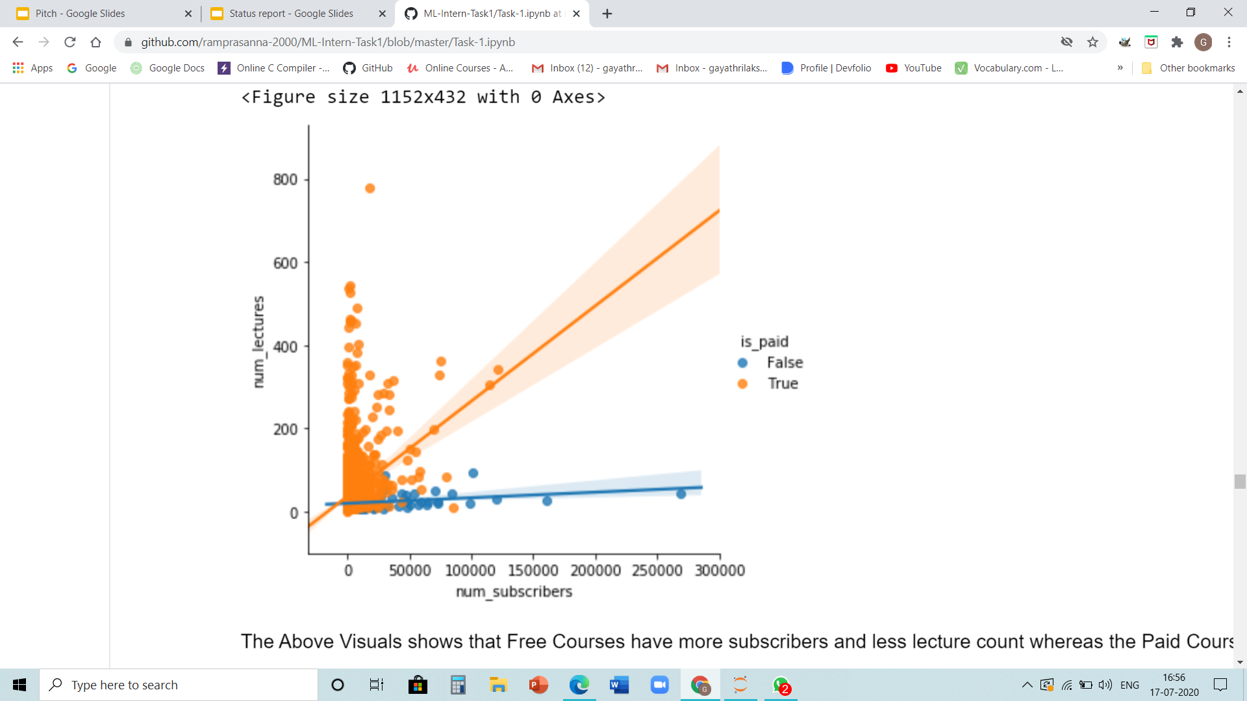
Visualisations From the Correlation Matrix
Free Courses have more subscribers and less lecture count compared to the Paid courses
The web development courses are less paid but generate more revenue,that is, there are more subscribers and in contrast the Business Finance courses are more paid and generates less revenue
Correlation between Number of Subscribers with number of Lectures

Slide 13
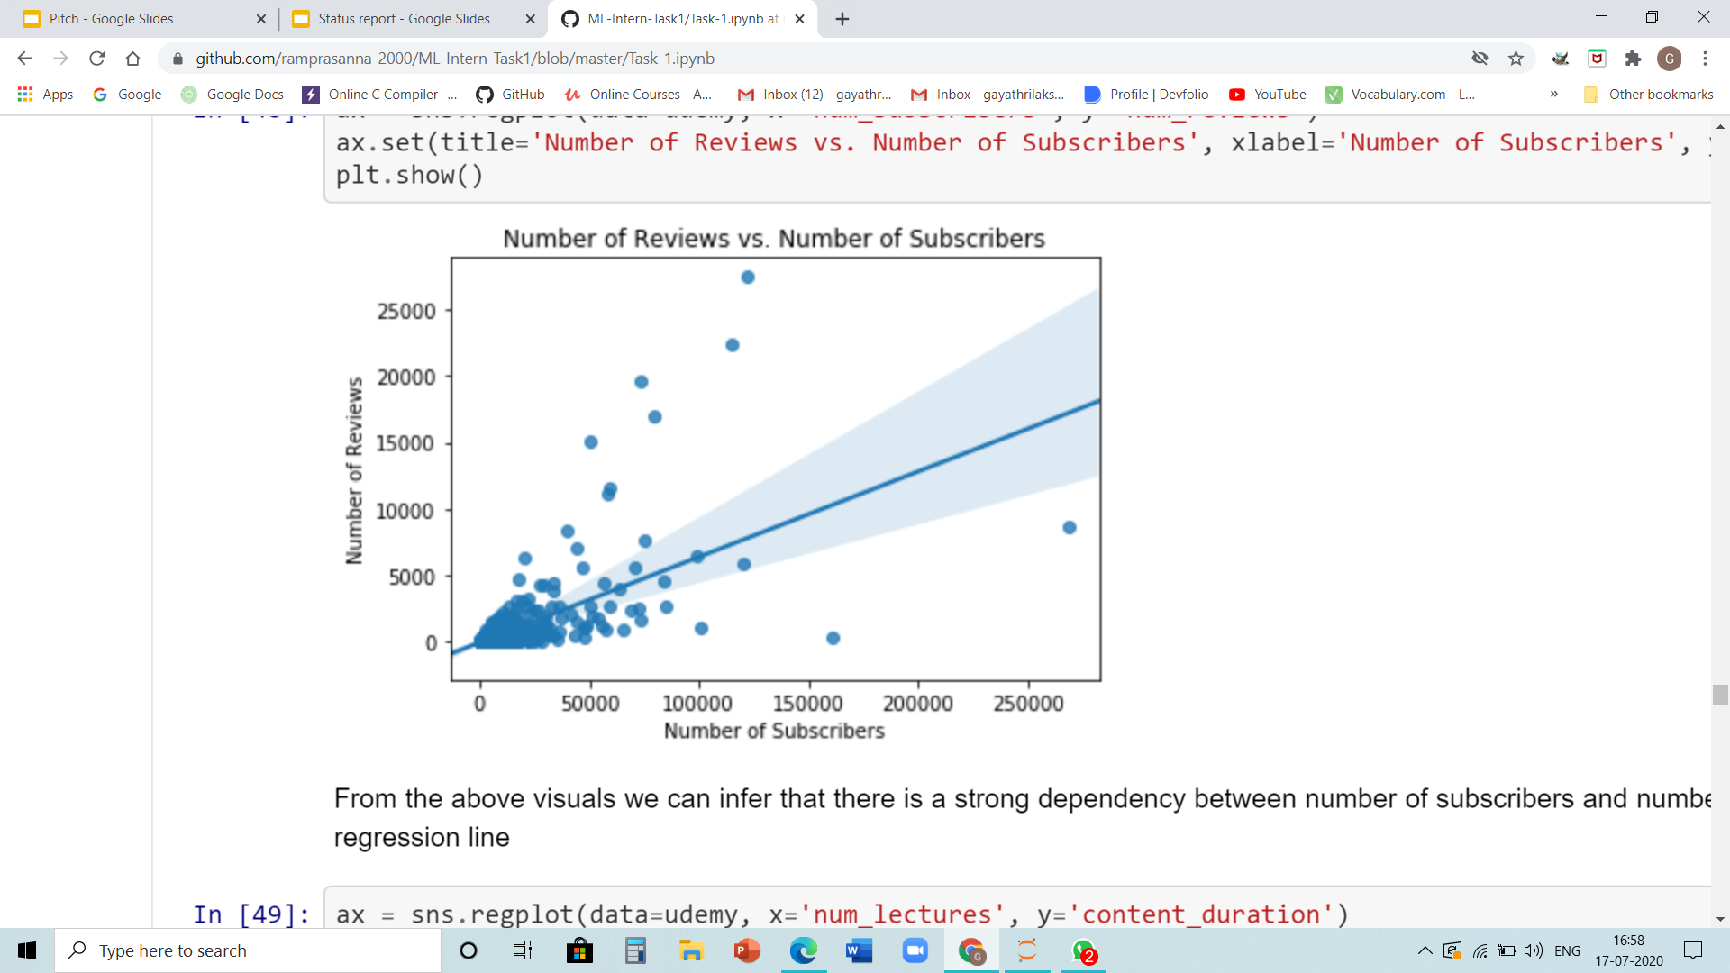
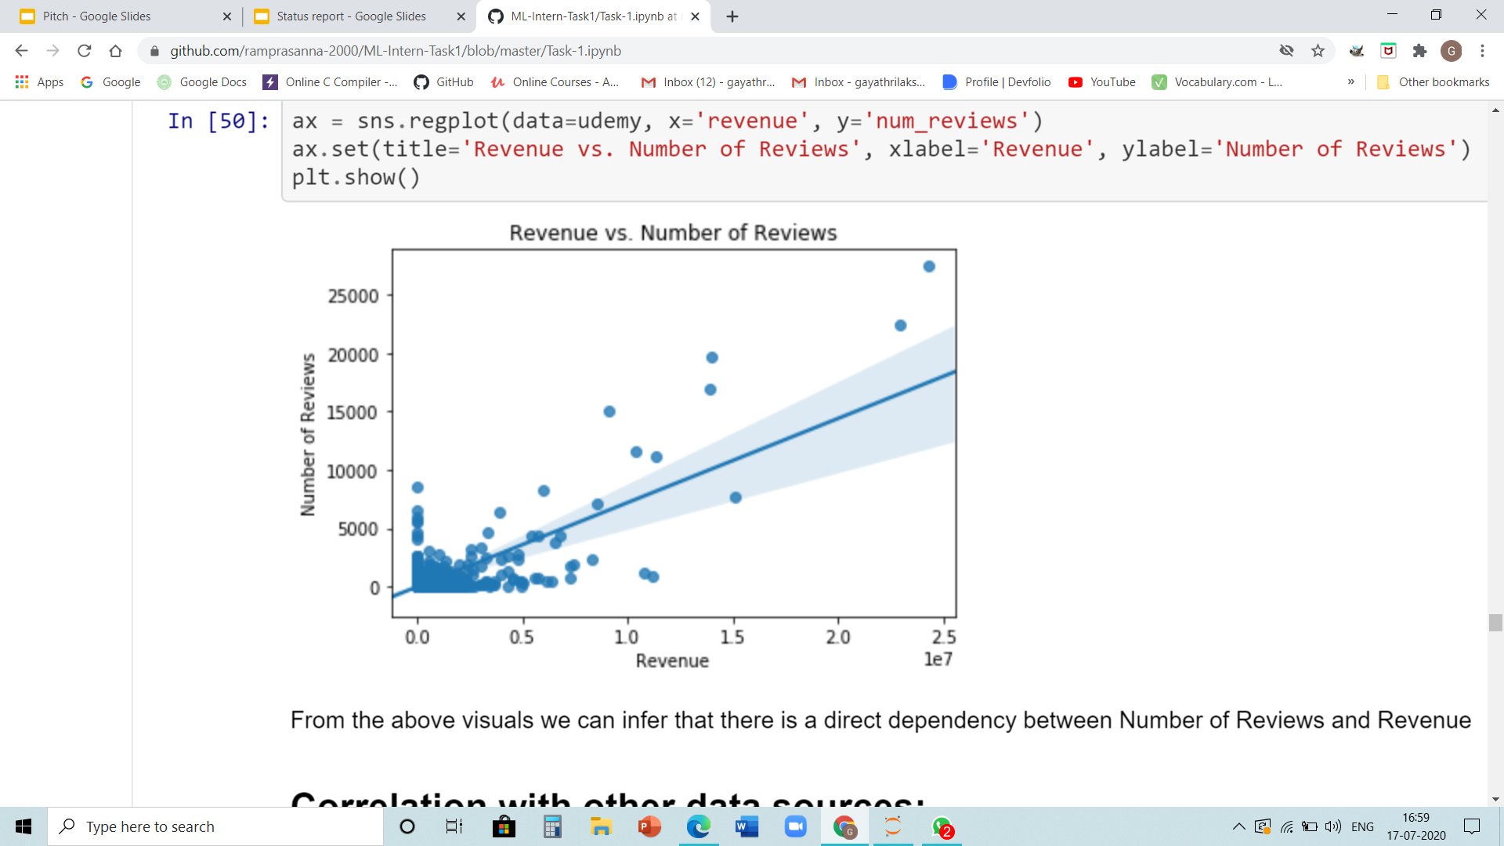
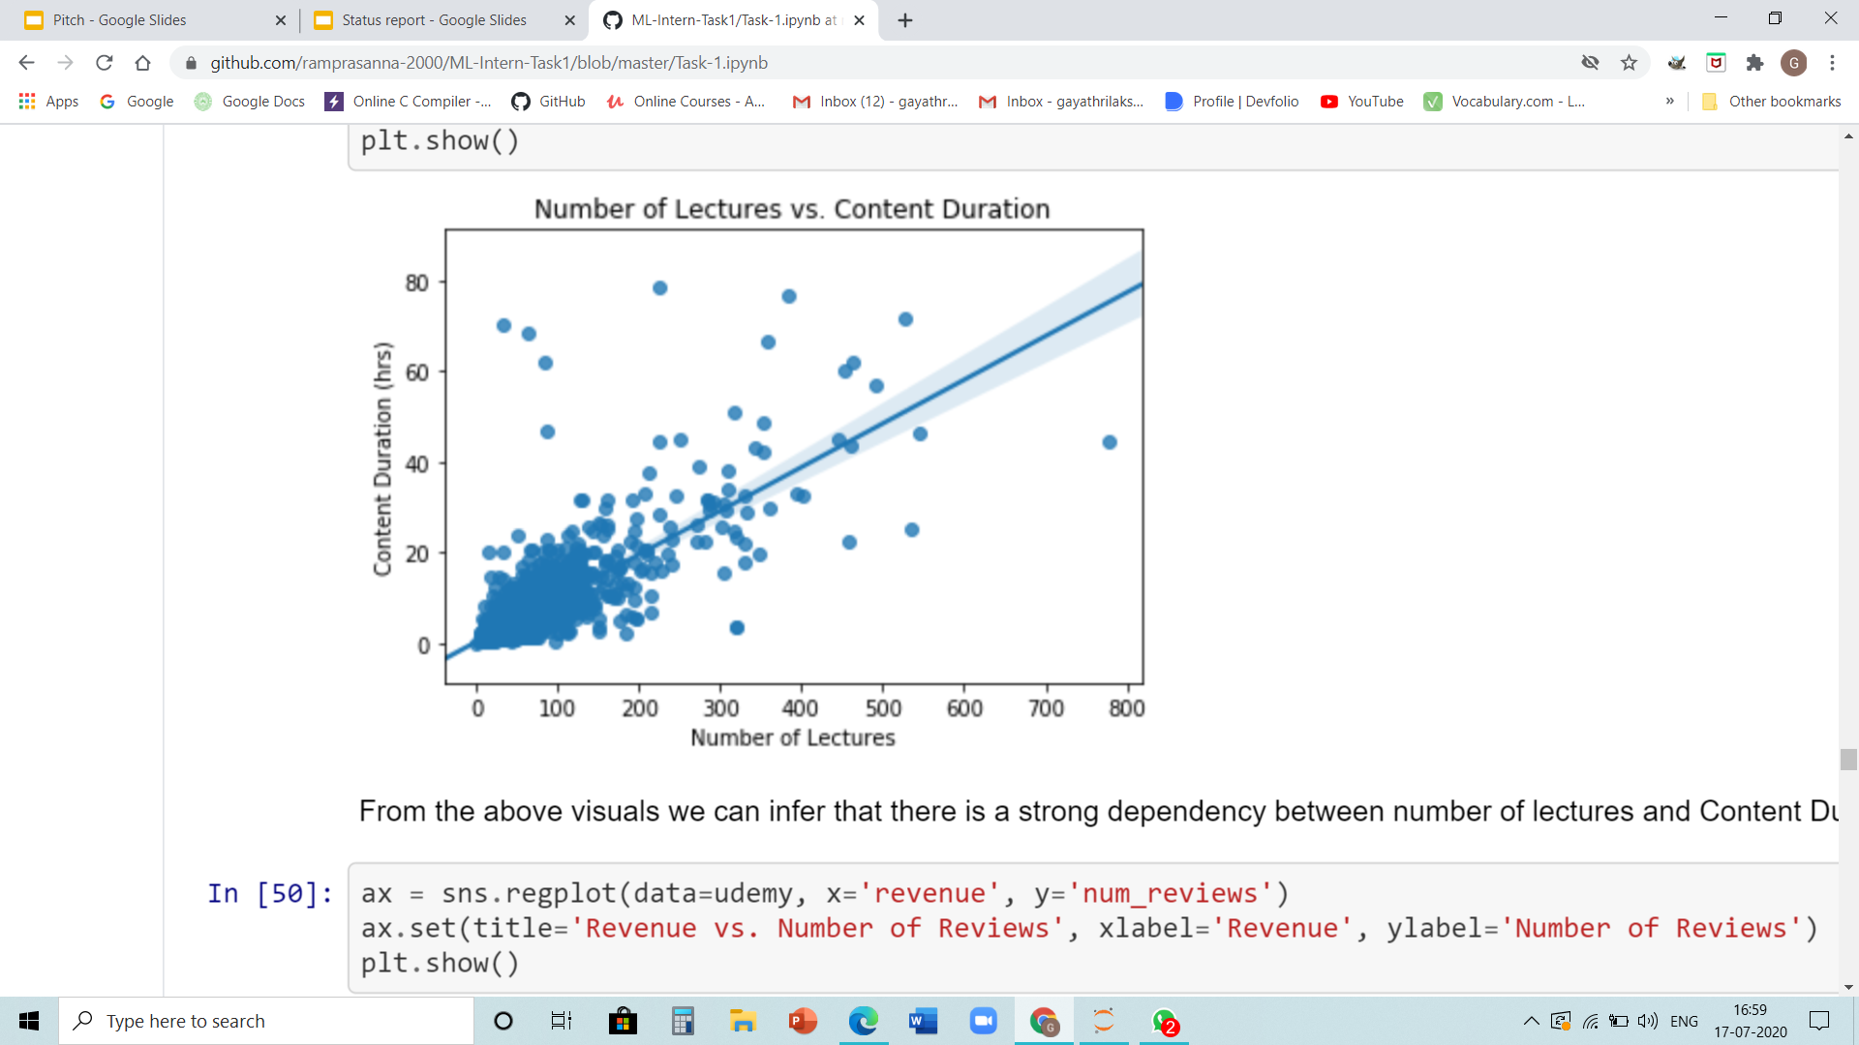
There is a strong dependency between number of lectures and Content Duration
There is a strong dependency between the number of subscribers and the number of reviews, which can be verified form the above regression line
There is a direct dependency between Number of Reviews and Revenue

Slide 14
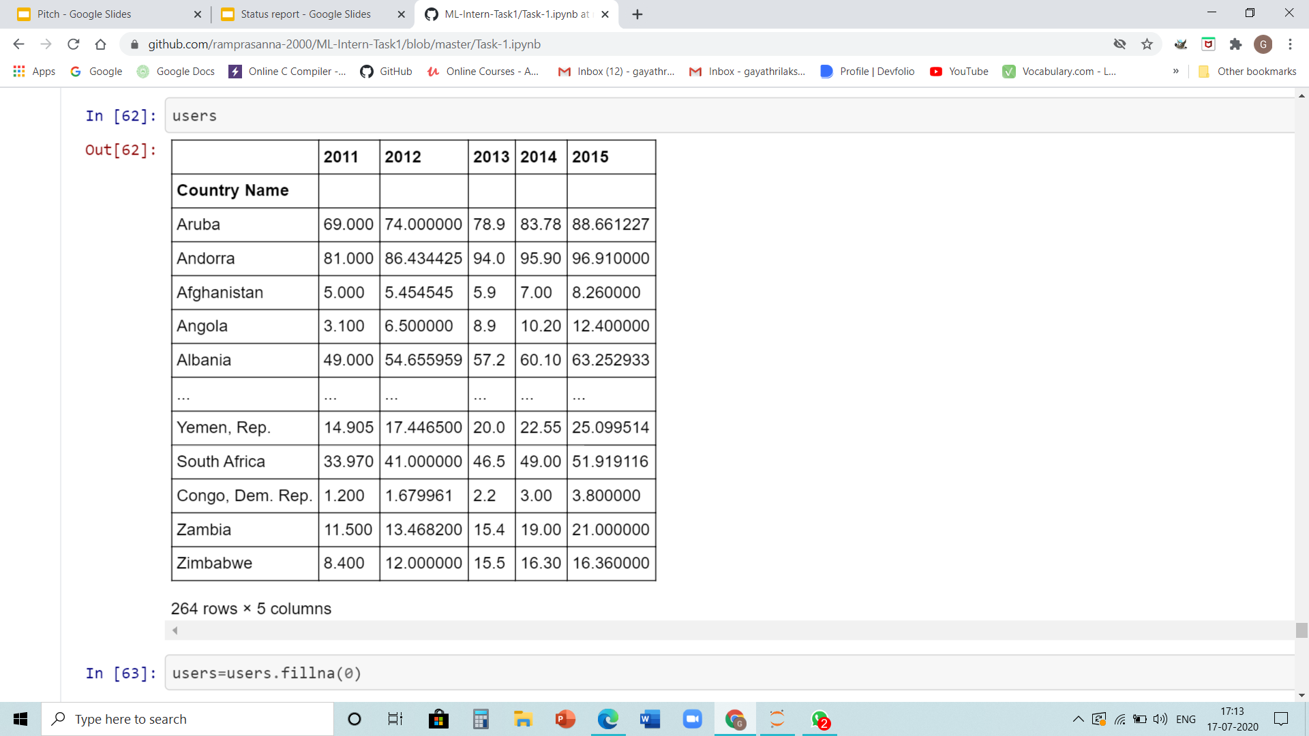
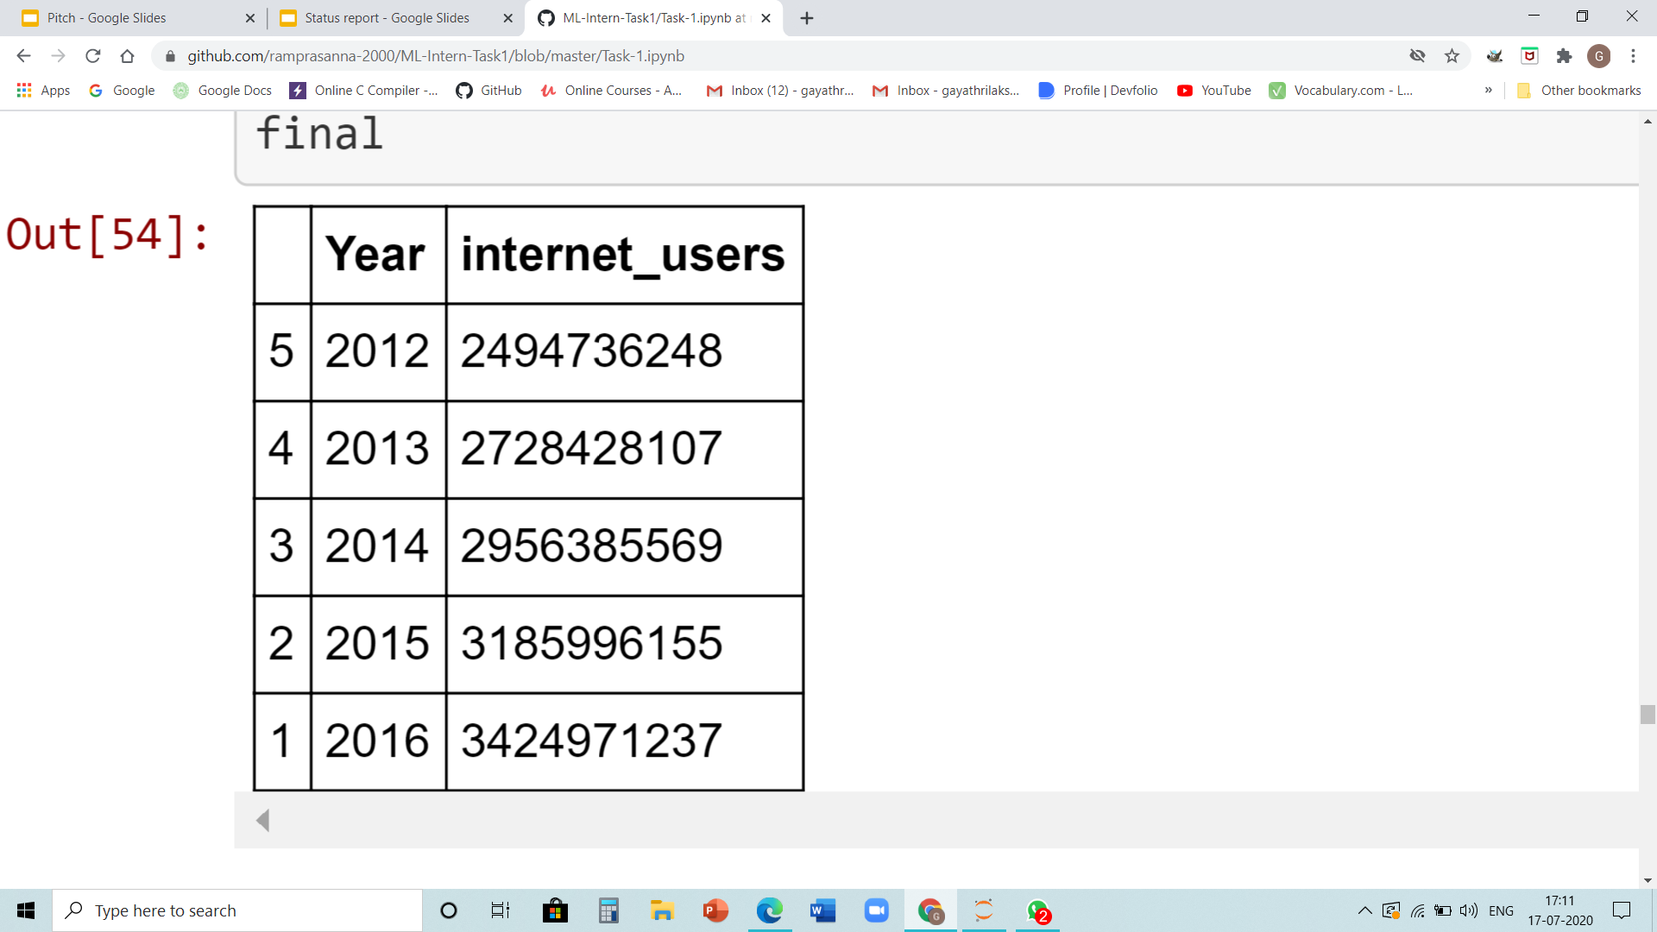
Correlation with Other Data Sources
The dataset used for correlation:

Slide 15
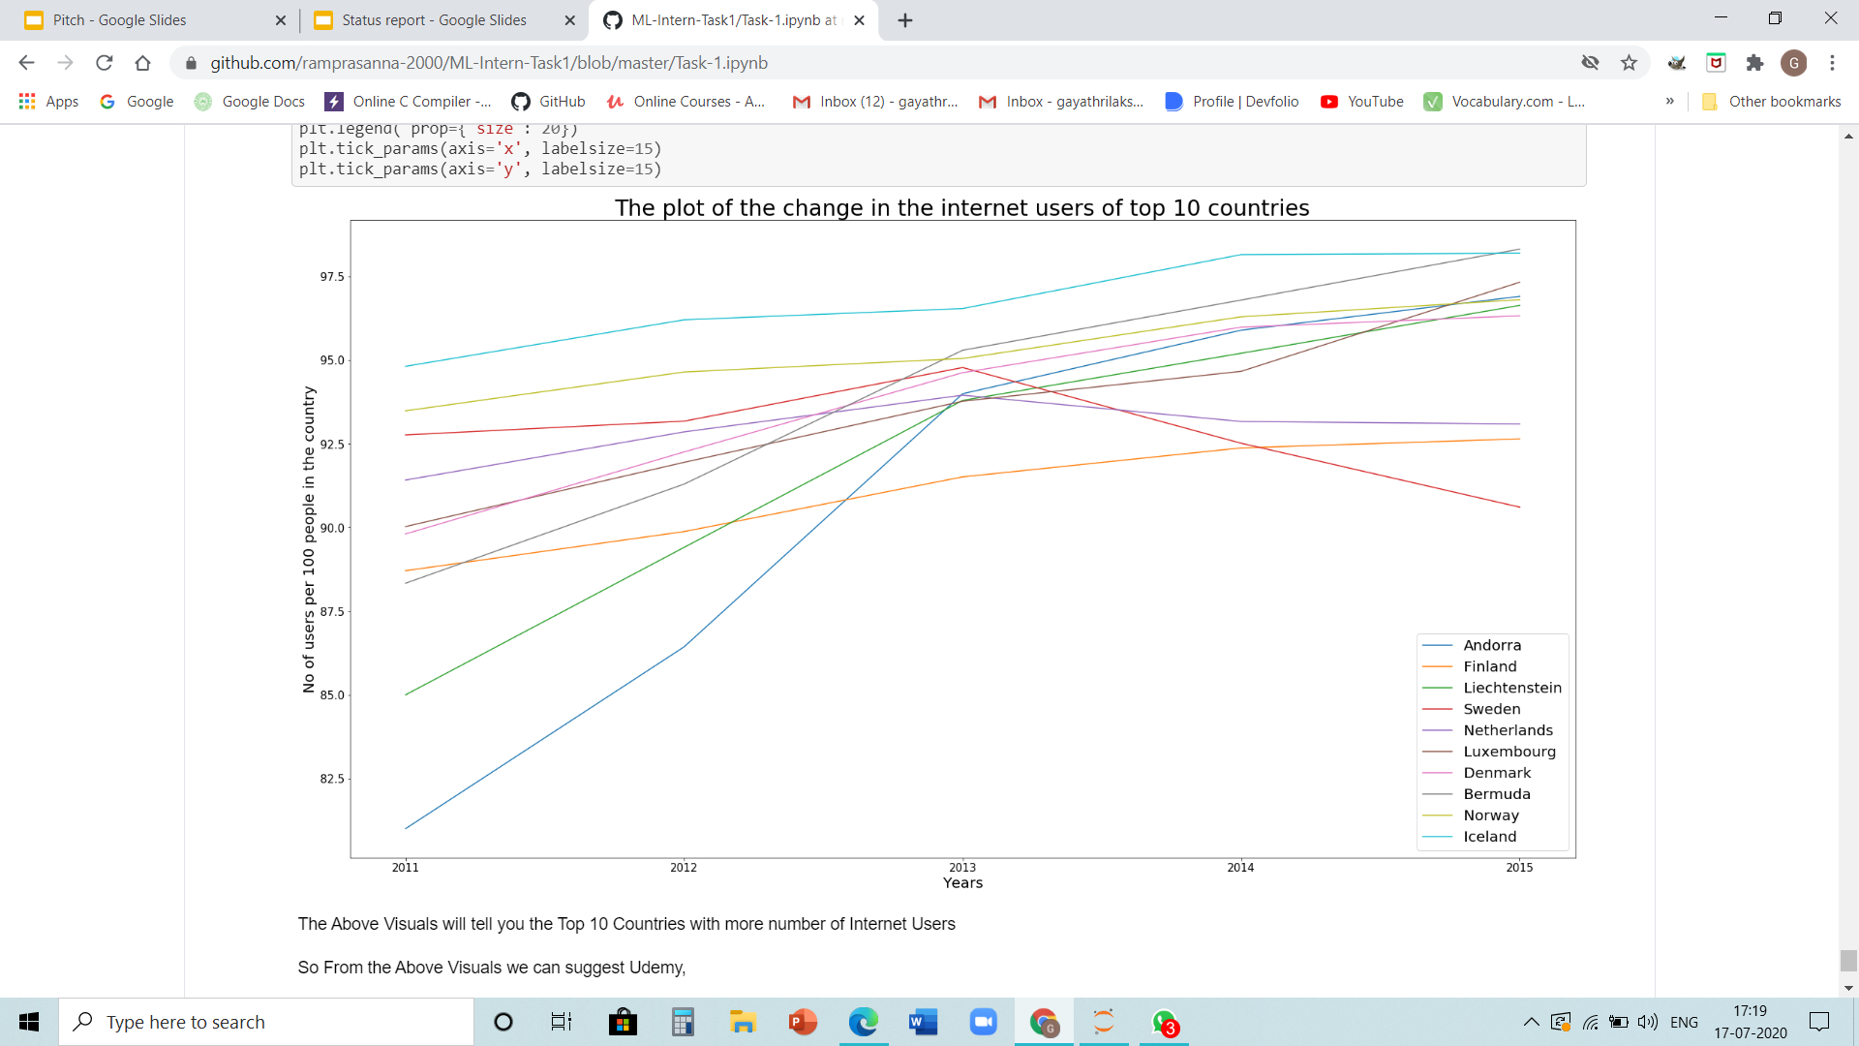
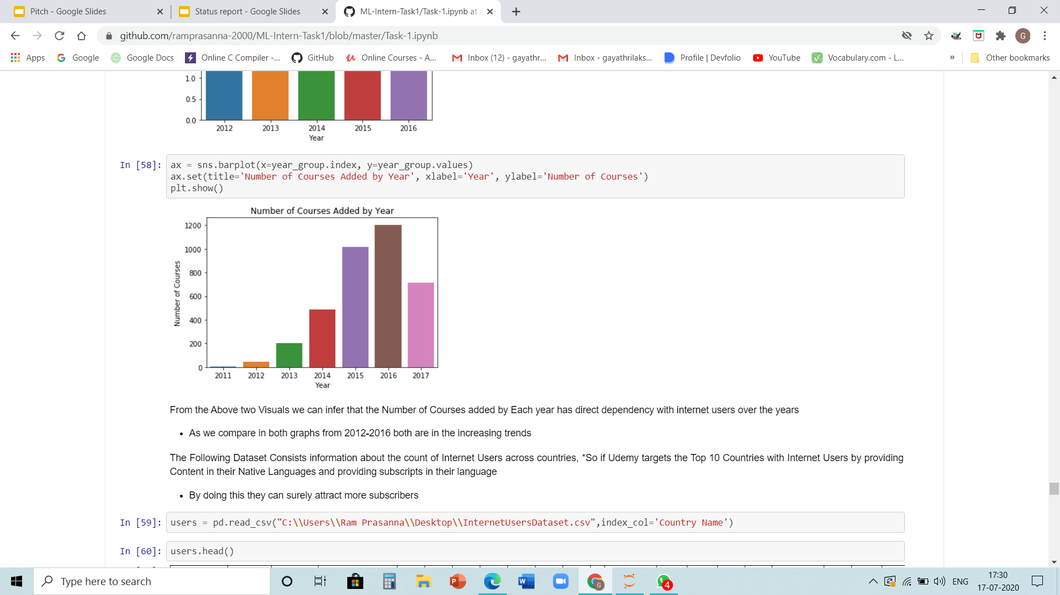
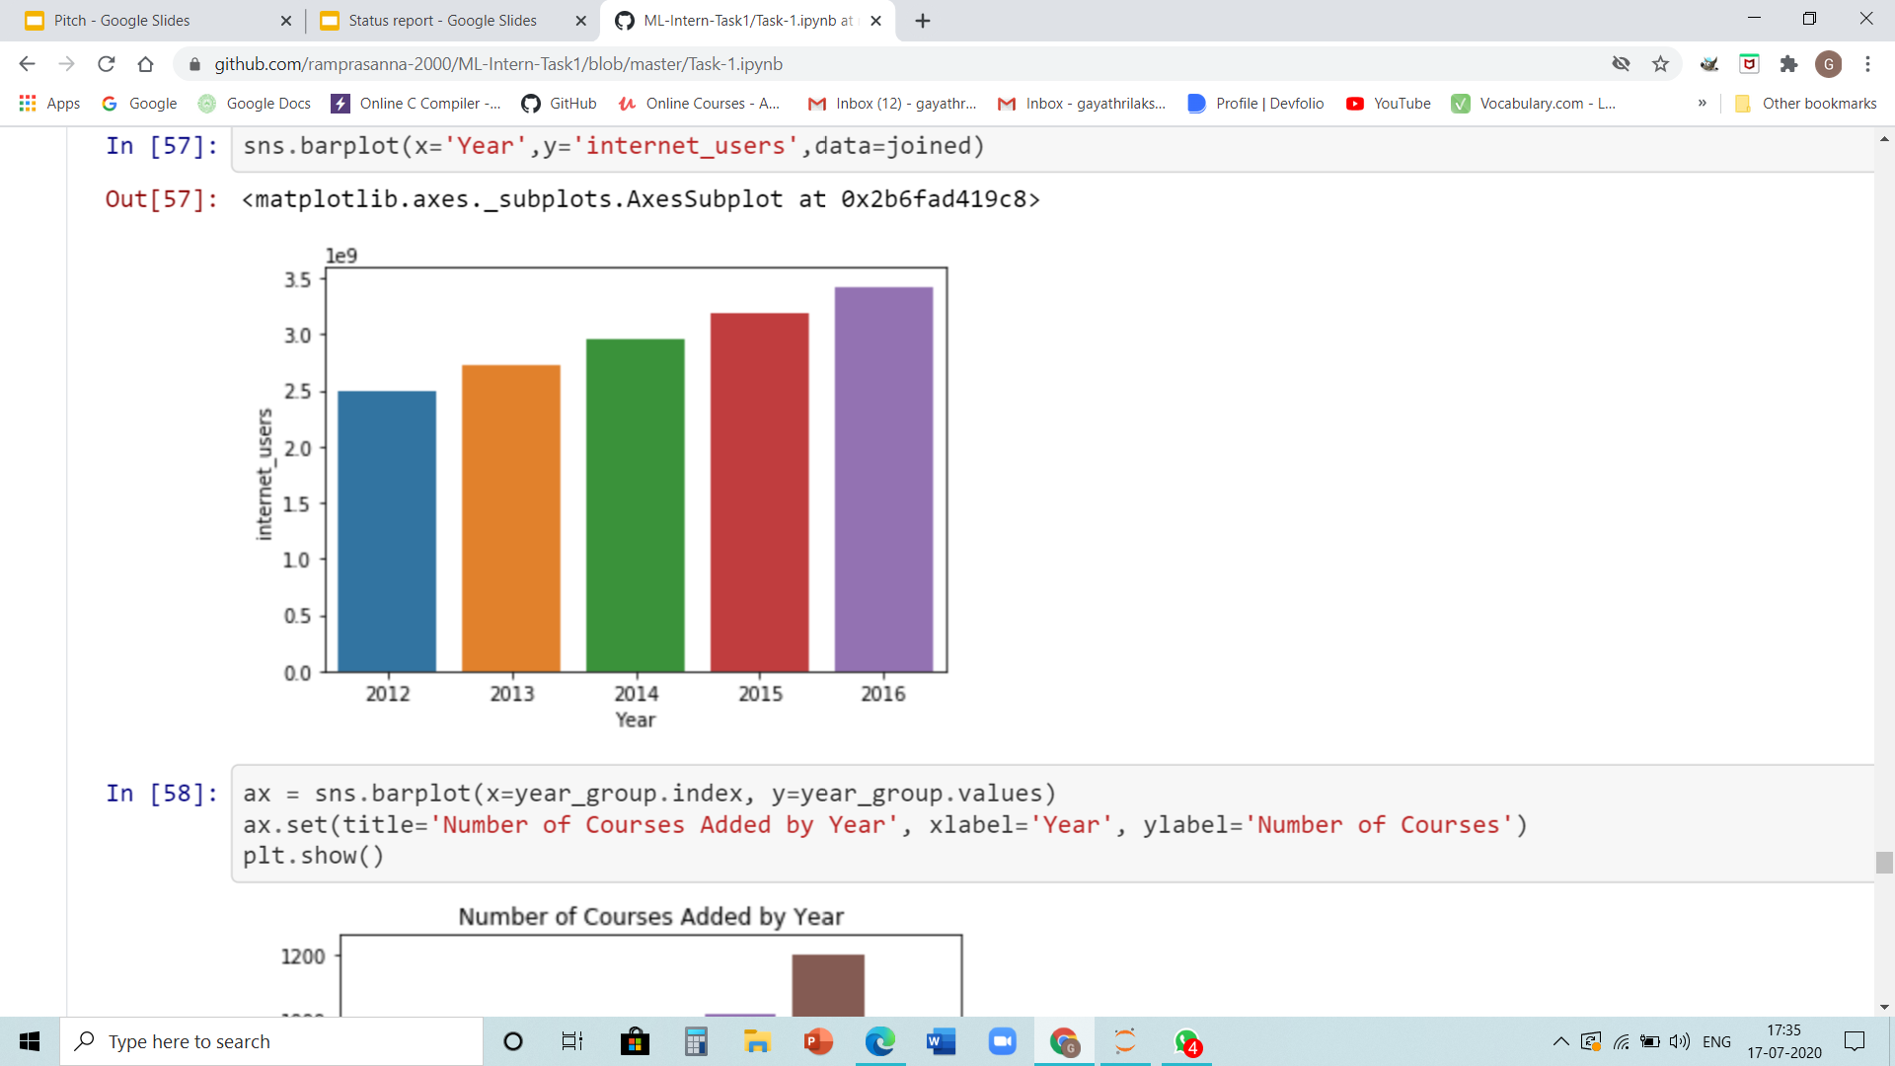
Visuals and Analysis:
3
1
2

Slide 16
Insights Drawn:
From the visual 1 and 2, we can infer that the Number of Courses added by Each year has direct dependency with internet users over the years
So From the Visual 3 we can suggest Udemy,
The Countries with more number of Internet Users
From the previous visuals we have proved that the number of Subscribers is directly proportional to Number of Internet Users
So if Udemy also target these 10 Countries by providing content in their native languages and also provide subscripts in their languages
From the Above Analysis we can sure that if Udemy target those audience then there will be more number of Subscribers

Slide 17
Thank You!!

